Slide 1
NBA Game Analytics
DAMG 7275 – PROJECT TEAM 6
Krishika Singh - 002194016
Mohammad Rafi Shaik - 001525707
Shika Shyam - 002194543
Shreya Soni - 002146758

Slide 2
CONTENTS
01
Objectives
02
Design and Architecture
03
Entity Relationship Diagrams
04
Implementation Process
05
Implementation Screenshots

Slide 3

Objectives
One stop shop for data on teams, players, games, statistics and more.
Player Statistics and Performance tracking
Team performance analysis
Player Career trajectory tracking
Visualizing team networks and similarities between players
Game statistics and historical analysis

Slide 4
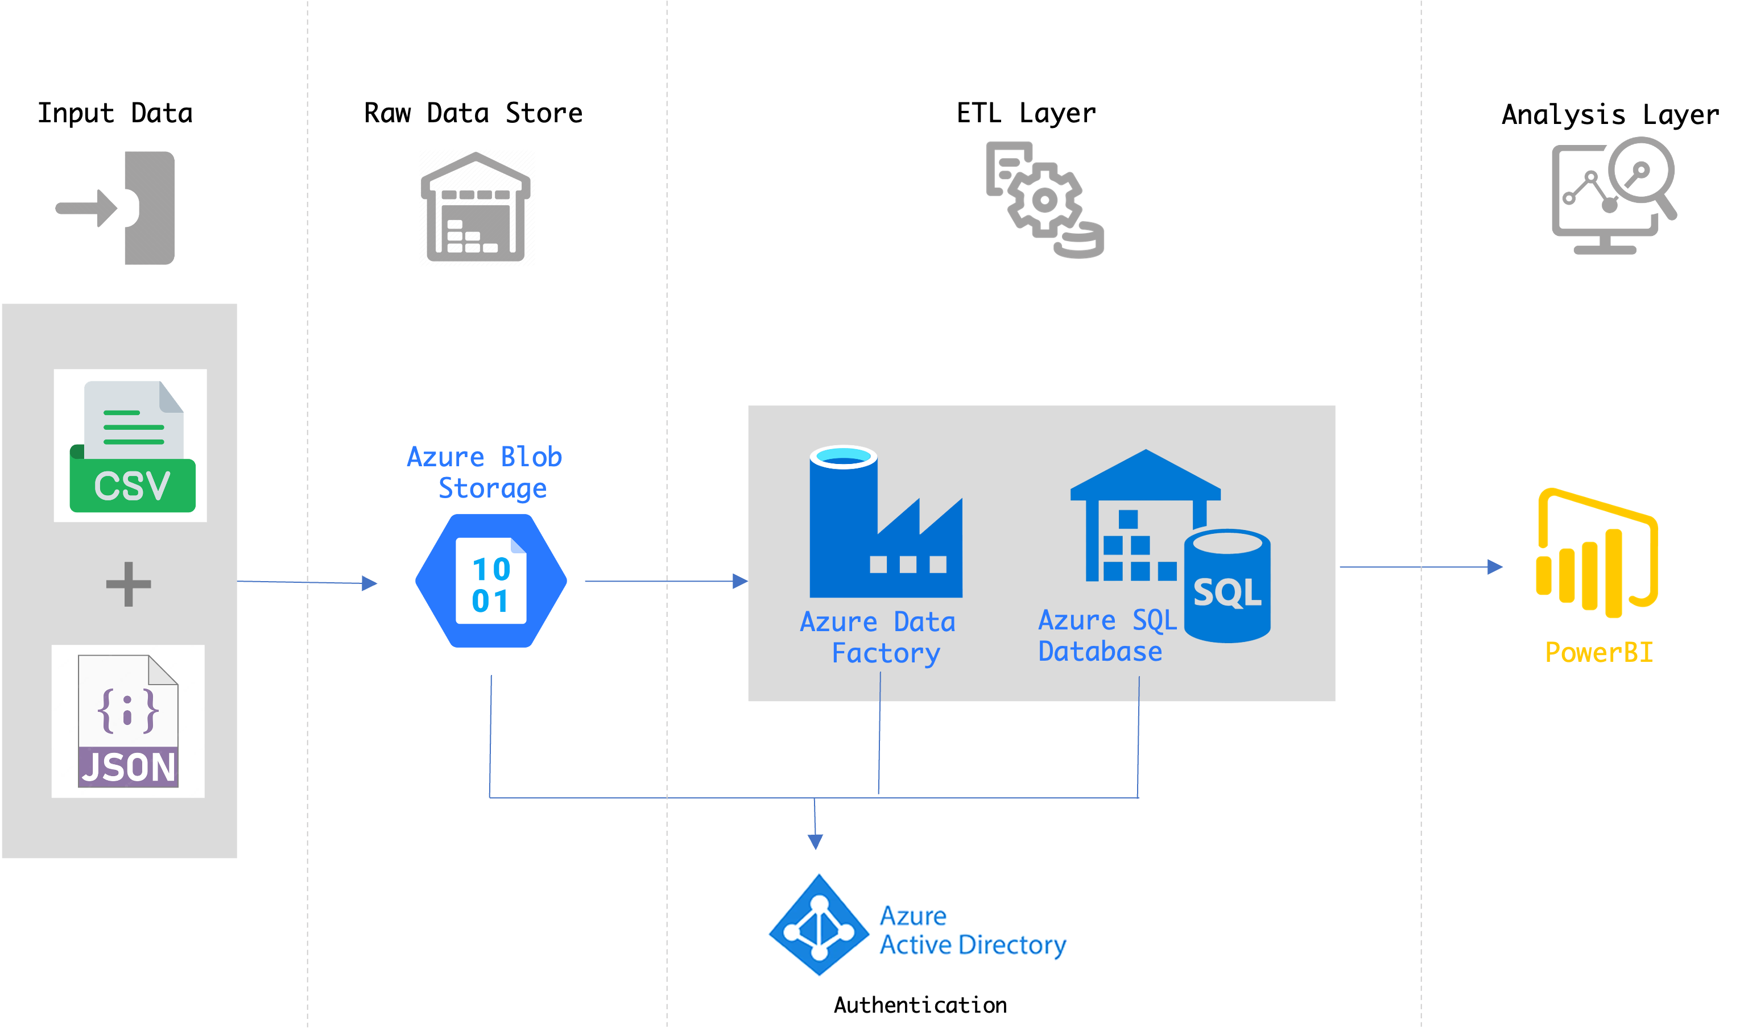
Design and Architecture
Azure SQL Multi-Model architecture

Slide 5
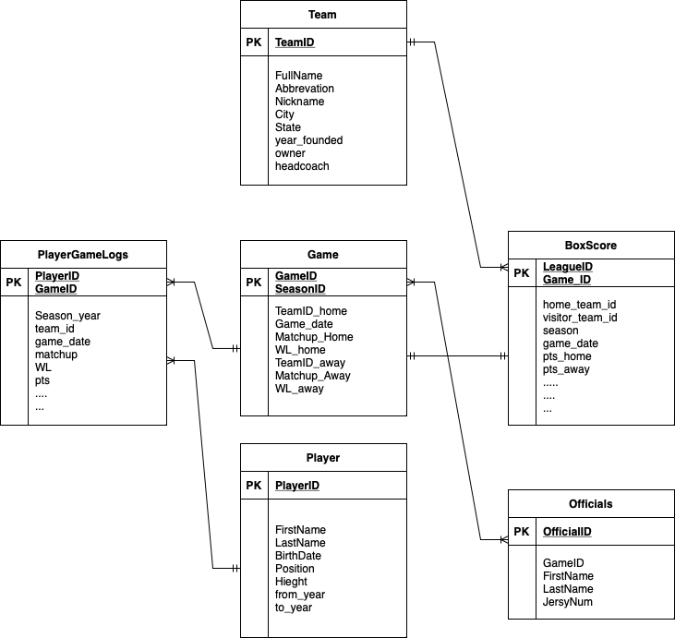
ER Diagrams
Relational and Document
Document based data stores
PLAYER and PLAYER_LOGS tables in the ERD could be combined into a single document in the document database that contains all the information about a player, including their logs, stats, and other related information. This can allow for faster and more efficient querying of player information, as well as easier data management and maintenance.

Slide 6
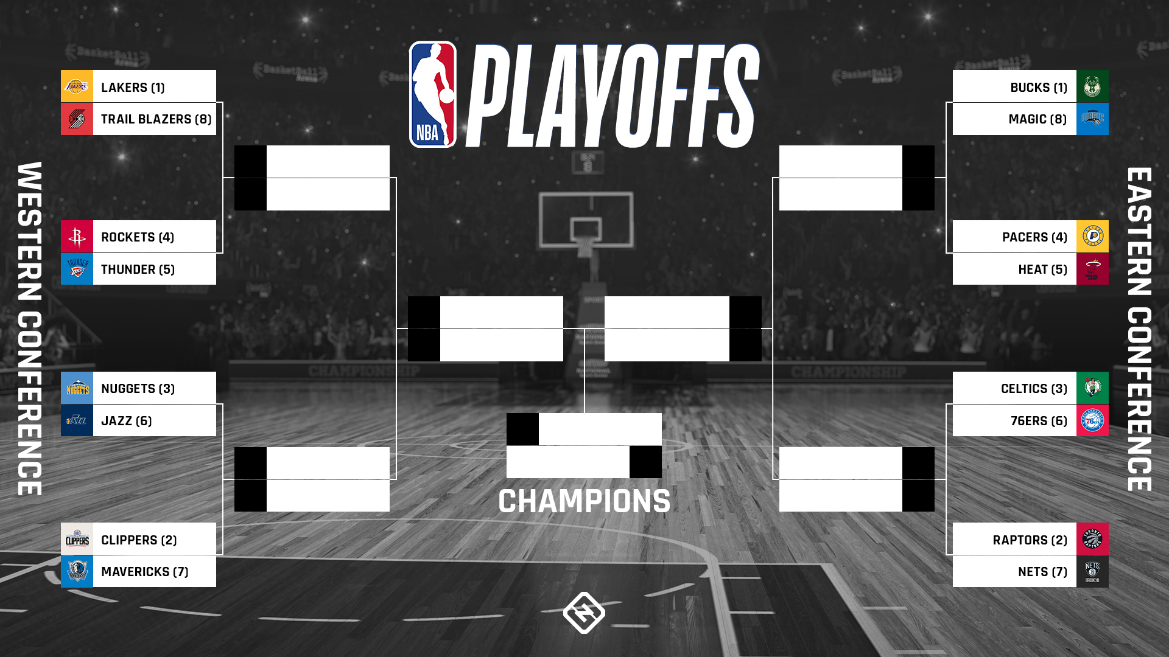
ER Diagrams
Graph
Player
Player
Player
Player
We are using Graph DB to simulate team progress in Leagues as shown below
PLAYS_FOR
Team
PLAYS_FOR
PLAYS_FOR
Team
PLAYS_FOR
PLAYS_IN
Game
PLAYS_IN

Slide 7
Implementation Process
The data we are using is available in the NBA dataset provided by Kaggle. The data is in the form of multiple csv files for different entities.
Since these CSV files are not normalized and has a lot of redundant columns we will be needing extensive preprocessing before we can use the data for reporting.
The implementation is in three phases :
1
2
3
Raw Data Layer
ETL Layer
Foundation Data Layer
We are using Azure Blob Storage to store the csv files from Kaggle.
We are also using Blob storage as the staging area for JSON documents.
Azure Data Factory is our ETL tool. We are using Data Copy activity for some entities and full-fledged data flows for others.
We have also enabled both schedule based and storage event-based triggers.
The sink of our ETL pipelines point to Azure SQL tables.
We are storing data as tables, nodes and edges for graphs as well as document.

Slide 8
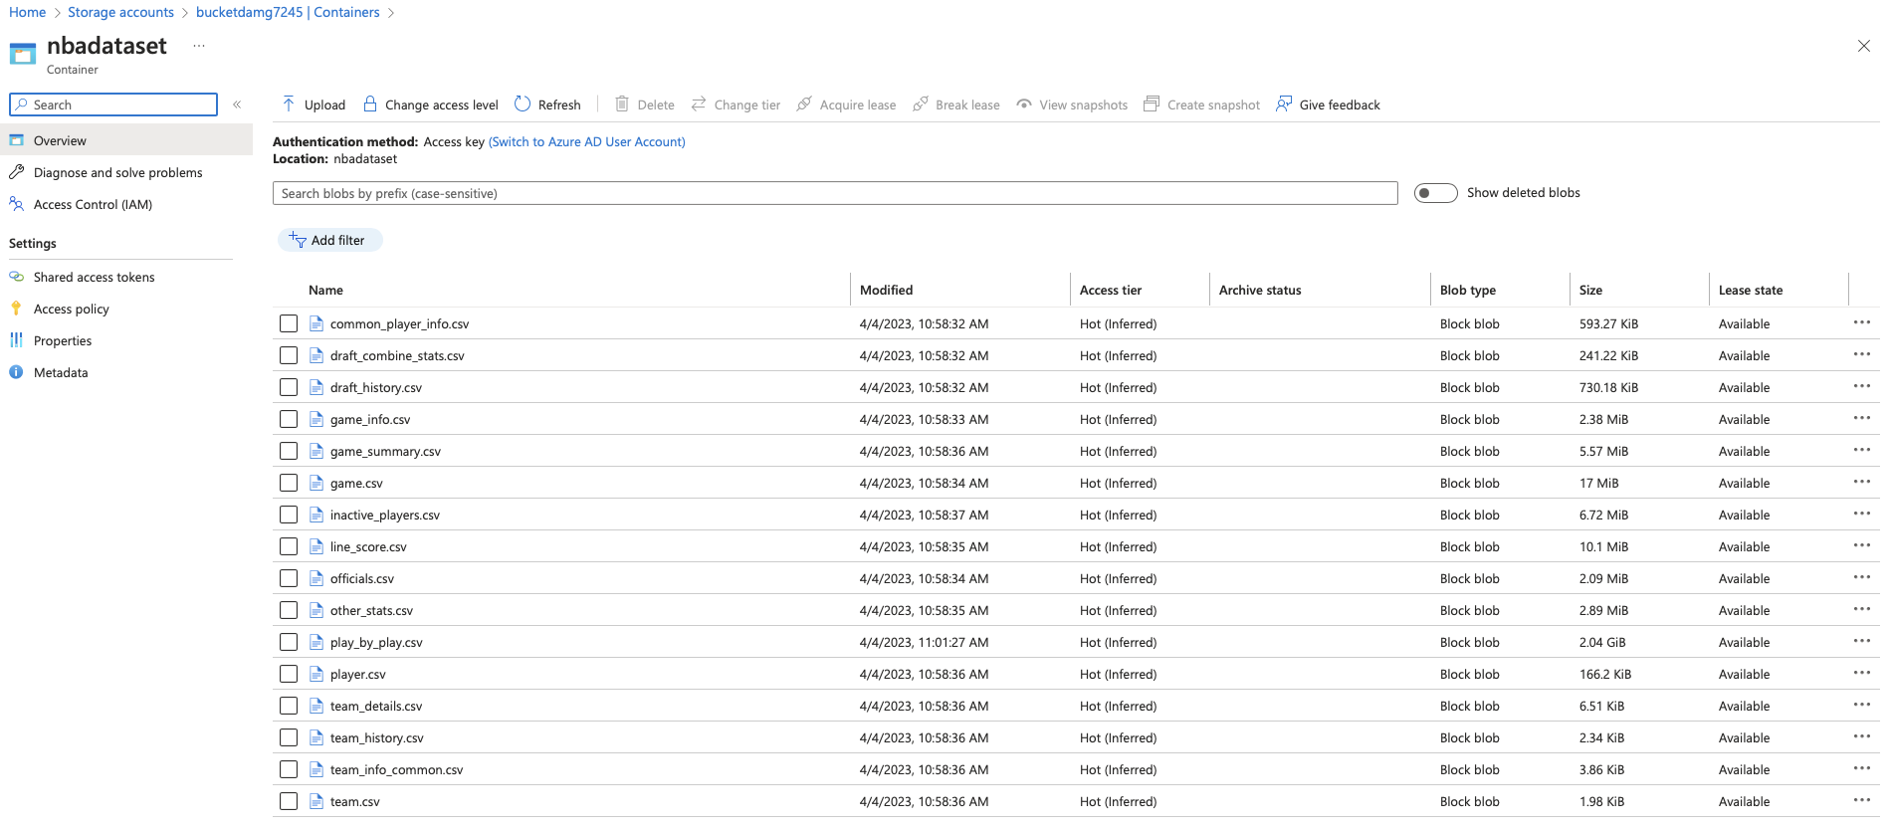
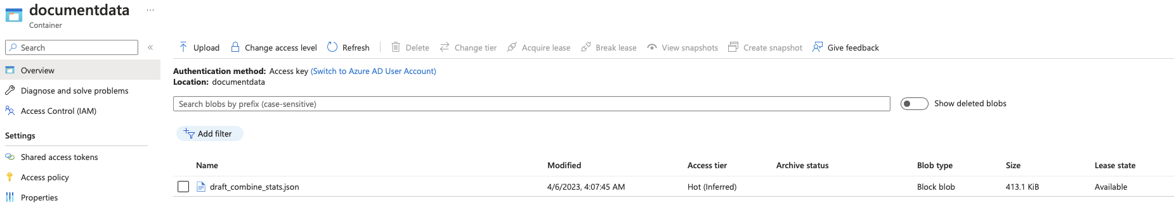
Raw Data Store
We have made use of Azure Blob Storage as shown below to store our CSVs. The source for all our ETLs will be pointing to this storage location.
nbadataset is the container where all our source csv files are available.
Additionally, we use documentdata container to store the staging json file that we create from the csv in order to store as document in foundation layer

Slide 9
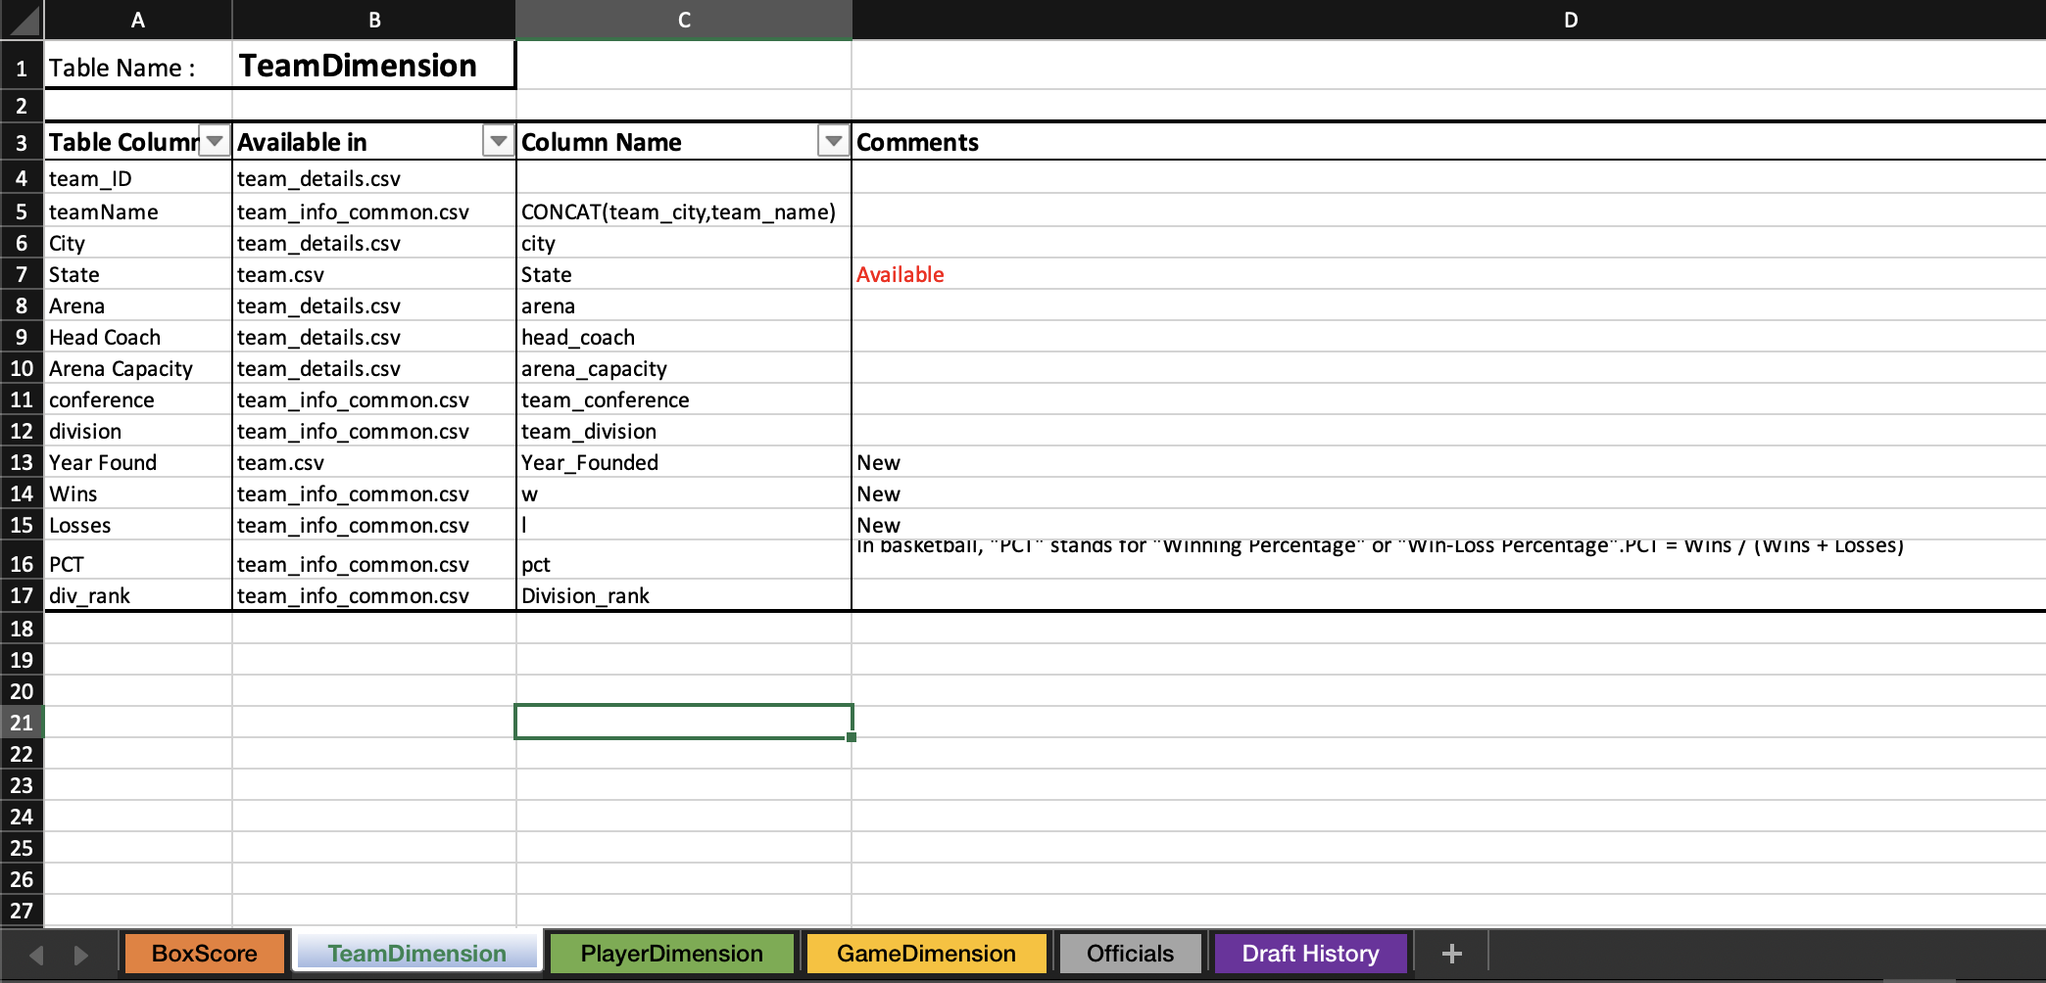

ETL Layer Design
Since we have multiple source csv files our first step in ETL Design was to create a consolidated data dictionary as shown below where we determine from which file the source data for each target column in a given table comes from.
We created this for all columns in tables in our Foundation layer.

Slide 10
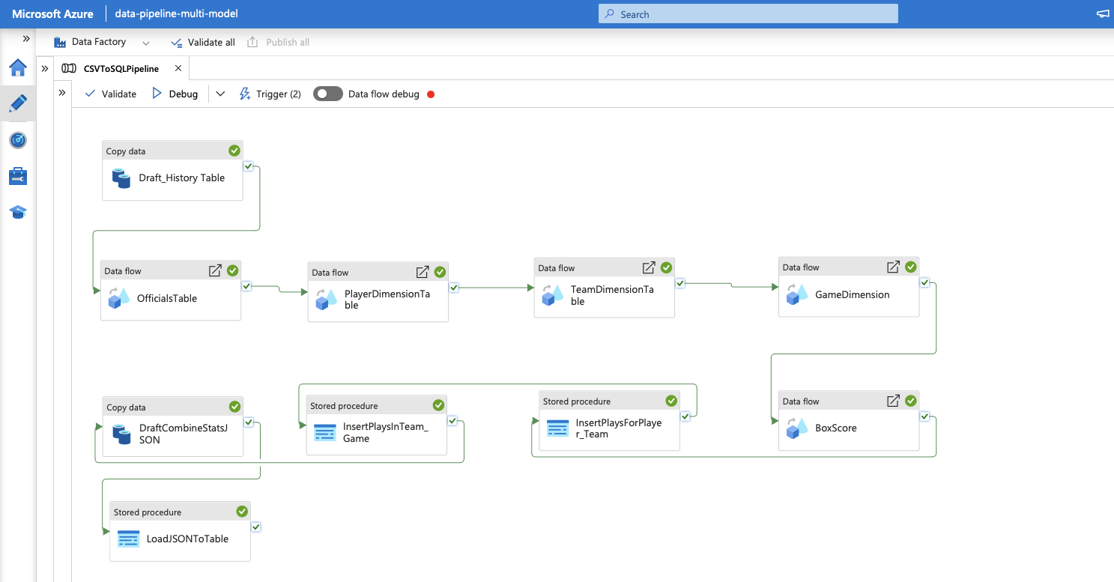
ETL Layer
We have created the below ETL pipeline for our project. It loads each entity in the order of execution, and runs the required stored procedures in target after loading. Due to the cost constraints that come with using heavy clusters for ADF jobs, we have traded off on the parallel runs and decided to run each component of the ETL sequentially.

Slide 11
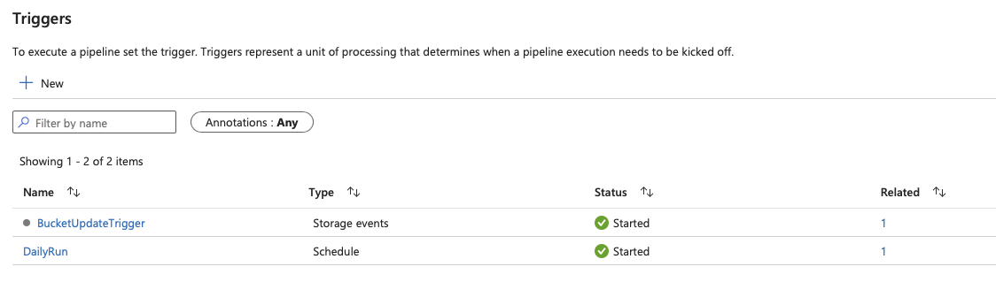
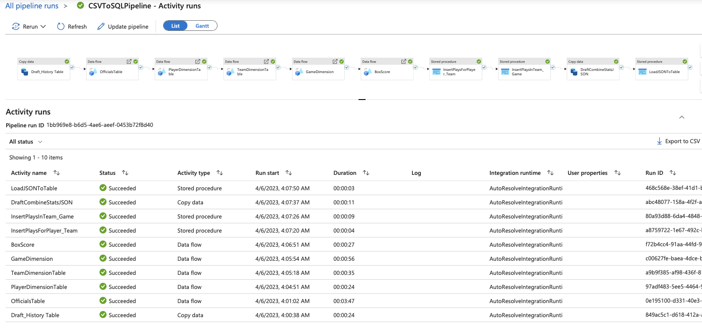
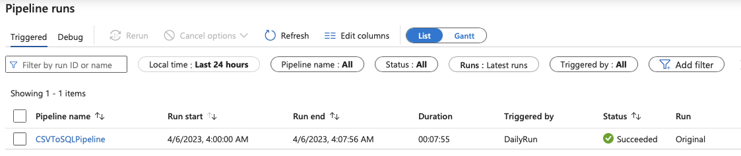
Pipeline Triggers
We have set up two types of triggers for our pipeline –
There is a Scheduled trigger called Daily Run – which is scheduled to run everyday at 12AM UTC
There is a Storage Events Trigger called BucketUpdateTrigger - which will run every time there is a new file added or updated in our Raw Data Storage Container
We can see above that all the steps of our ETL pipeline has run

Slide 12
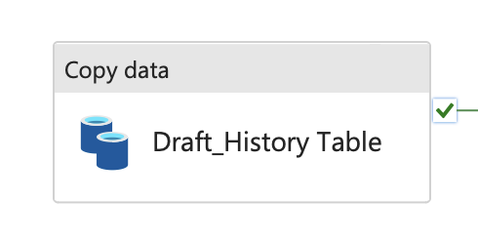
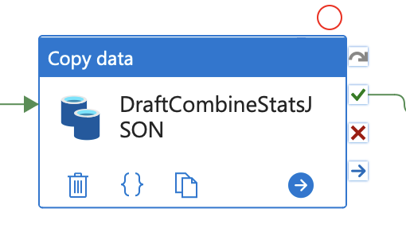
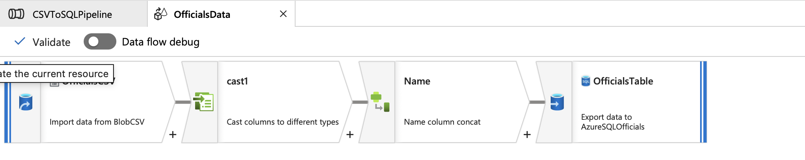
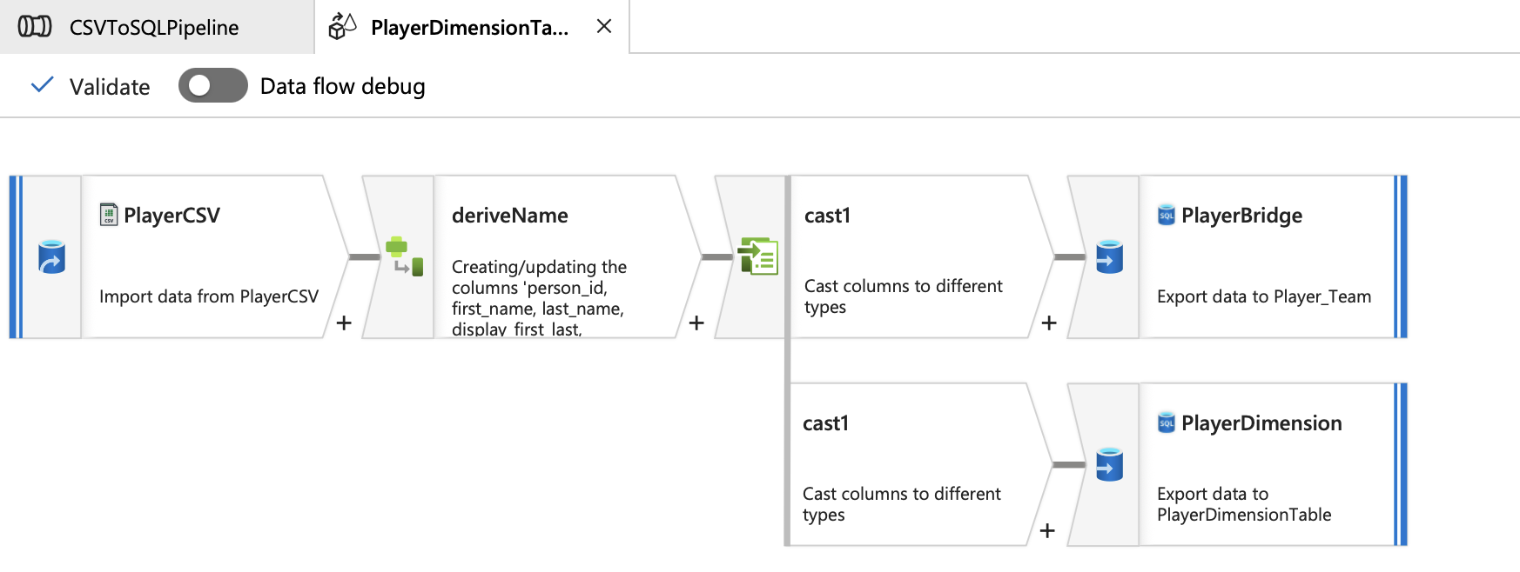
CopyData and DataFlow activities
We use CopyData Activity for one table:
Draft History Table : Since this table requires a direct pull with the omission of a few columns from one single source csv file, we can leverage Copy Data Activity Here. Additionally, we use CopyData activity for converting the csv file into JSON format for our DocumentStore table – PlayerDraftStatistics
We have ADF Dataflow components for OfficialsTable PlayerDimensionTable, TeamDimension ,GameDimension and BoxScore

Slide 13
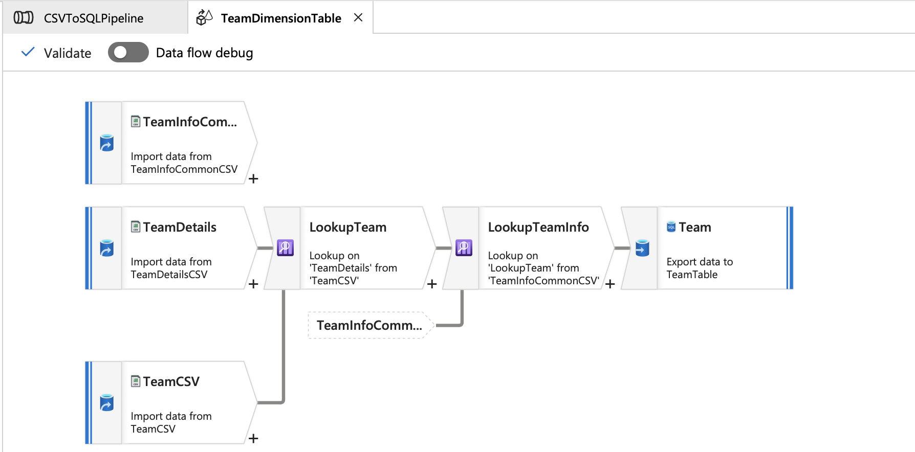
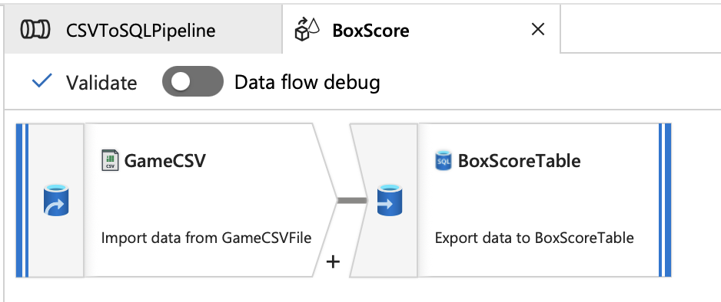
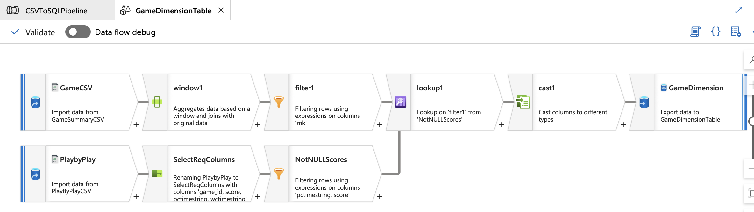
We also have 3 stored procedures that execute via our ADF Pipeline – these stored procedures and their details will be covered in the upcoming slides

Slide 14
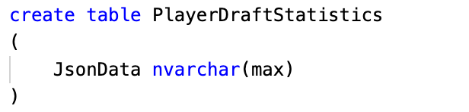
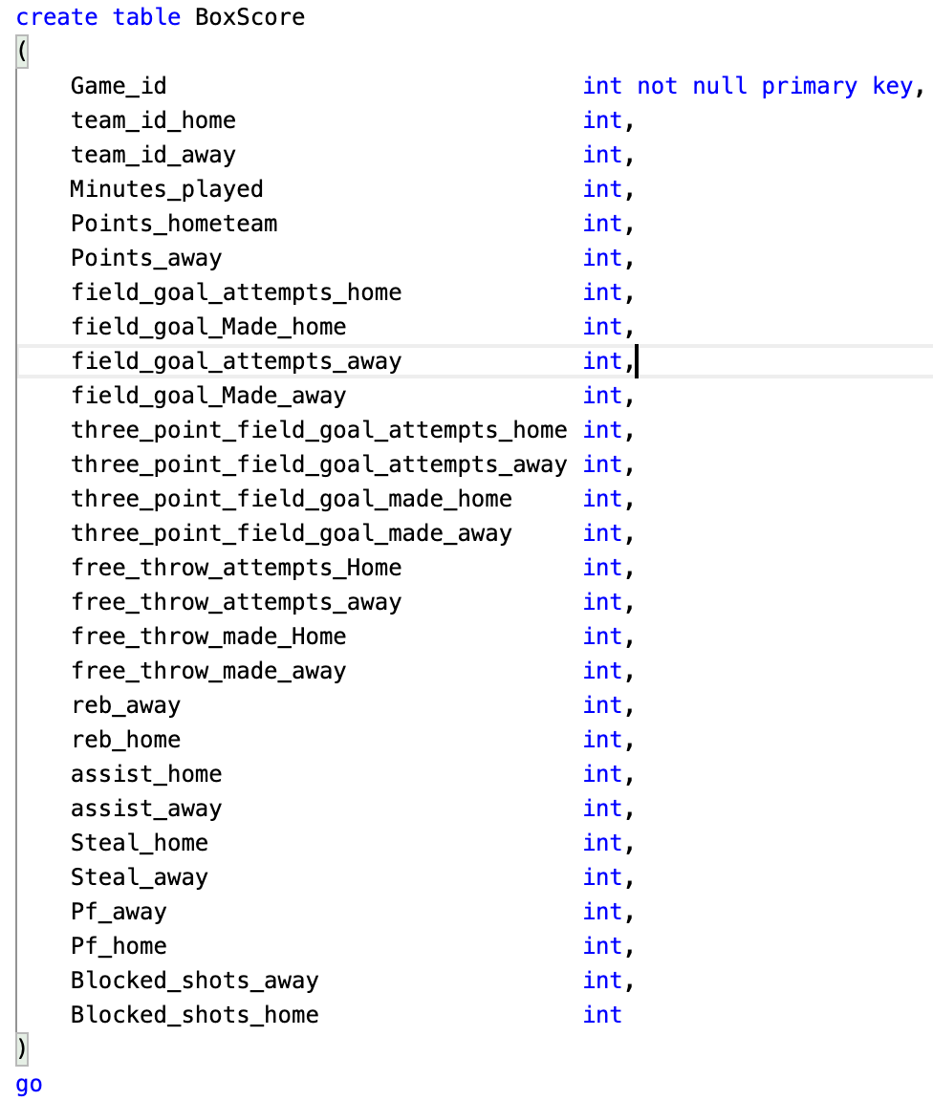
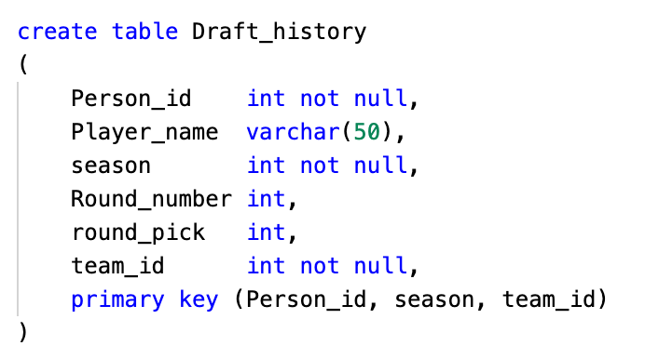
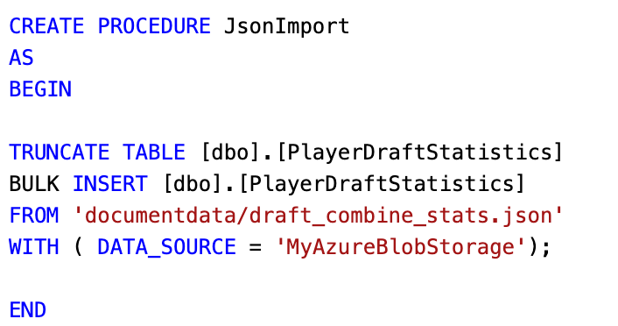
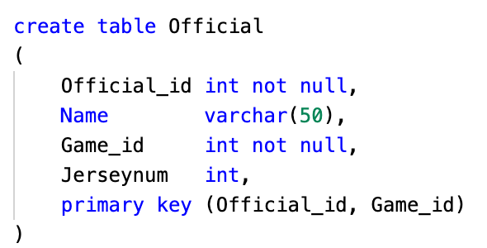
Foundation Data Layer
Like described in the ERD, we have three types of Data Store within Azure SQL:
Relational Data : Draft_History, Officials, BoxScore
Document Data : PlayerDraftStatistics
Graph Data : PlayerDimension, TeamDimension, GameDimension
The Relational Tables are created with the below DDLs and are loaded via ETL through Azure Data Factory
The Document model is created with the below DDL, and loaded using the stored proc below that pulls the JSON data from the Azure Blob Storage which is defined as a DATA SOURCE within our nba SQL Server
The stored procedure is executed within the pipeline in our Azure Data Factory

Slide 15
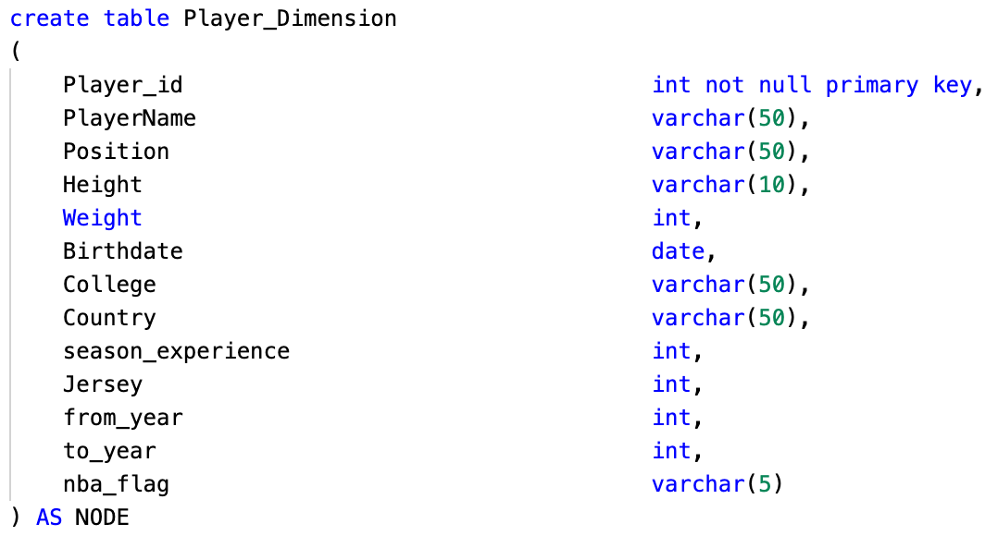
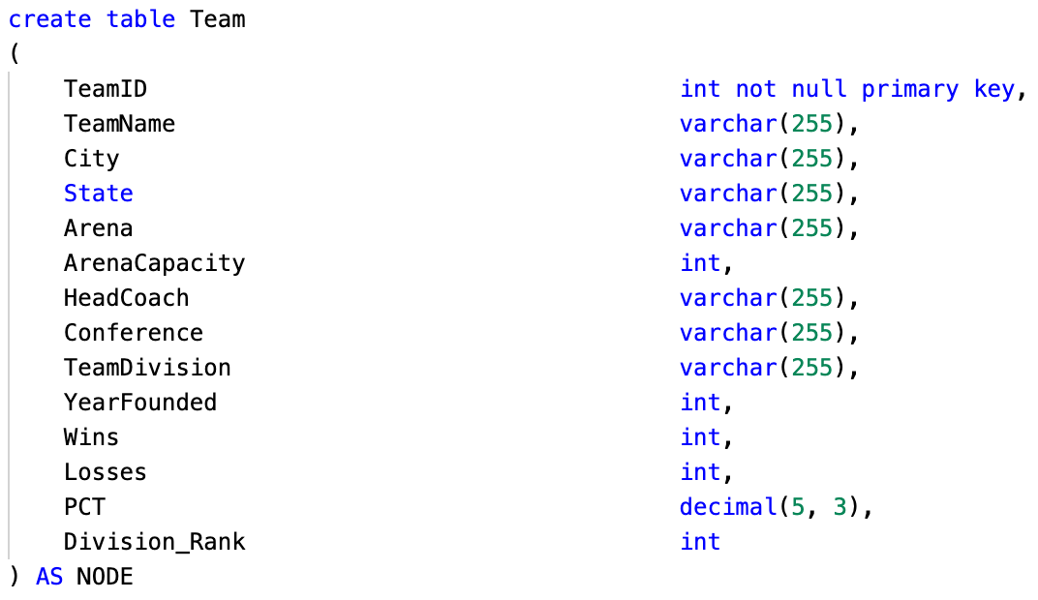
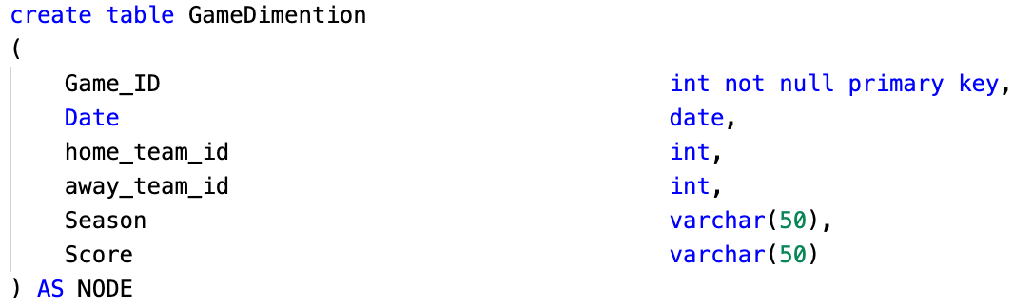
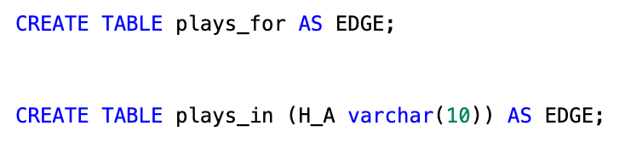
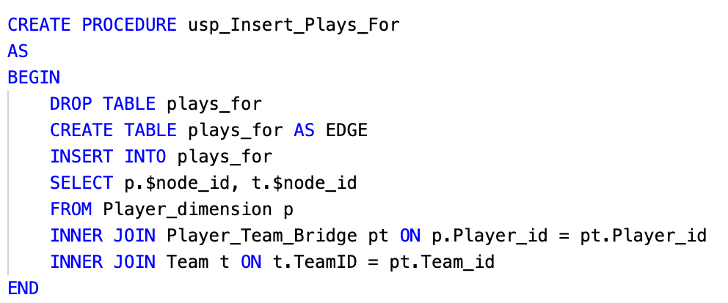
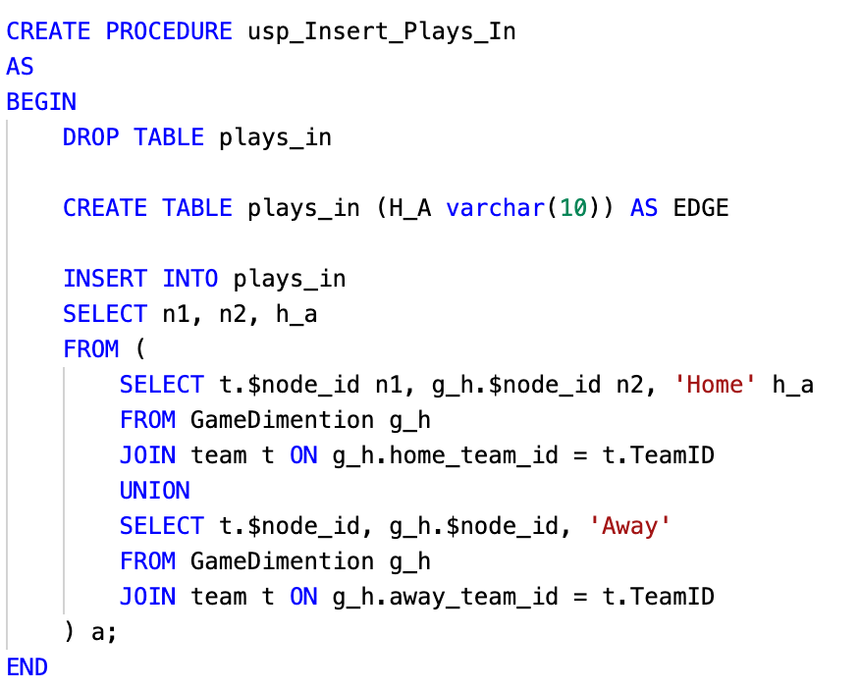
Foundation Data Layer
The Graph Data Model is created using 3 different entities as shown in the Graph ERD. PlayerDimension, TeamDimension and GameDimension. The DDLs are below:
The edge tables are also defined using the below DDL and two stored procs are leveraged to define the relationship between the nodes based on the source data.

Slide 16
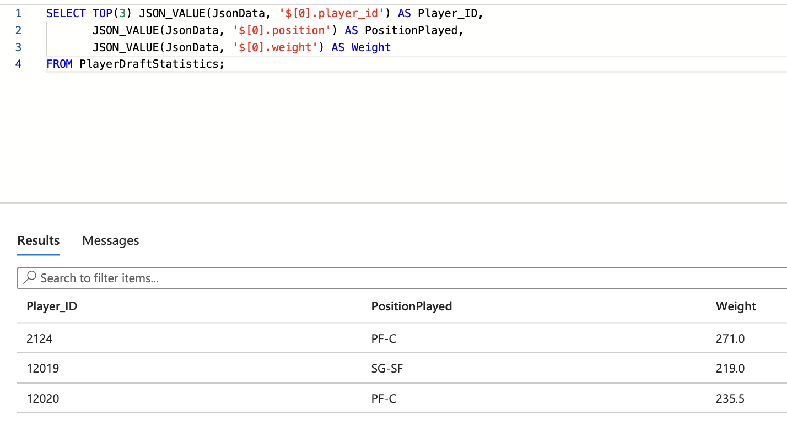
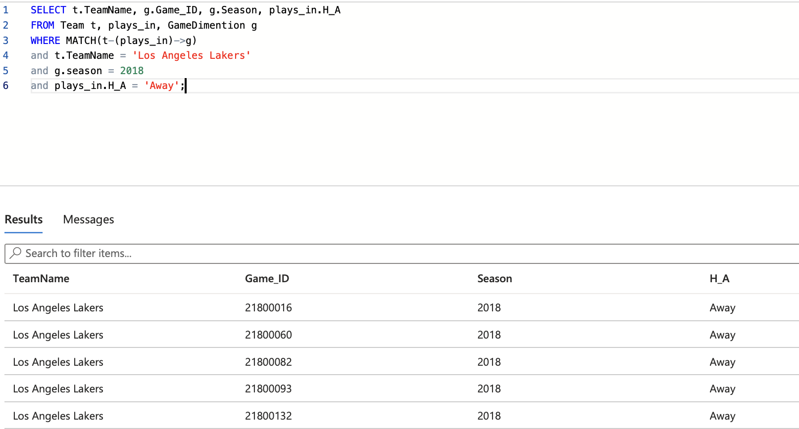
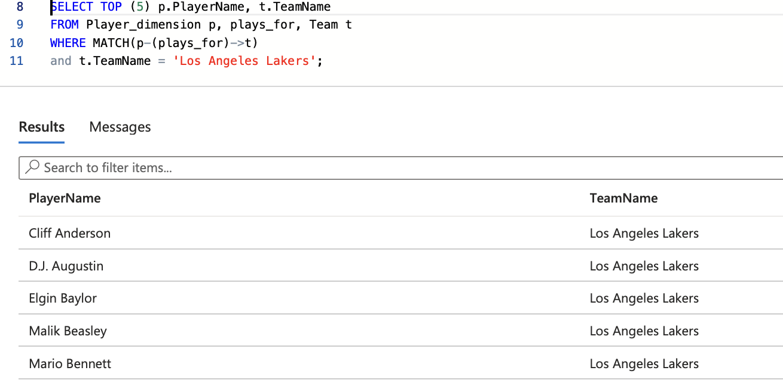
Sample Queries
As a part of P3, we have written some sample queries to be executed on the document and graph DB to ensure that data accuracy and integrity is in place.

Slide 17

Thank you!

